Slide 1
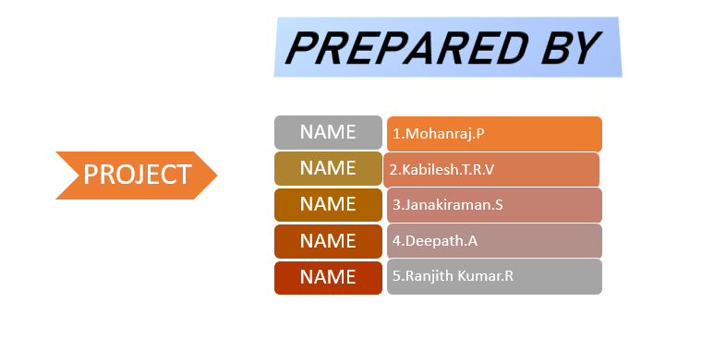
DEVELOPMENT OF SMART PUBLIC TOILET

Slide 2
DEVELOPEMENT 2 FOR SMART PUBLIC TOILET
WORKING MODEL:
The gas sensor is placed below the rim of the Toilet basin, to detect undesirable gases present in the confined toilet space. If the sensor detects the foul smell, it activates the motor and closes the lid. Once the lid is closed, touch sensor get pressed, which initiates the motor for automatic flushing. The gravity aurdino turbidity sensor detects quality of water by determining the intensities of turbidity. This sensor is deployed in the flush water tank to determine the quality of water and to check bacterial presence. If the turbidity level rises, it generates a signal and alerts the toilet maintenance team and displays Service Required message in the LCD Monitor connected to the door
As the user enters the washroom, he/she reads the LCD display connected to the door, if it displays Ready to Use message , user enters the toilet and put the hand over IR sensor to activate the motor, once the motor gets activated, it closes the toilet lid and automatic flushing is done. Once the toilet basin is clean, IR sensor is used to open the lid and the toilet seat cover. If foul smell is detected continuously it alerts the toilet maintenance team. The maintenance monitoring team worker will be provided with Radio Frequency Identification (RFID) tag, with identification code.

Slide 3
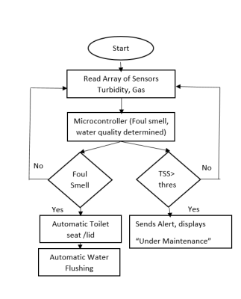
1.FLOW CHART

Slide 4
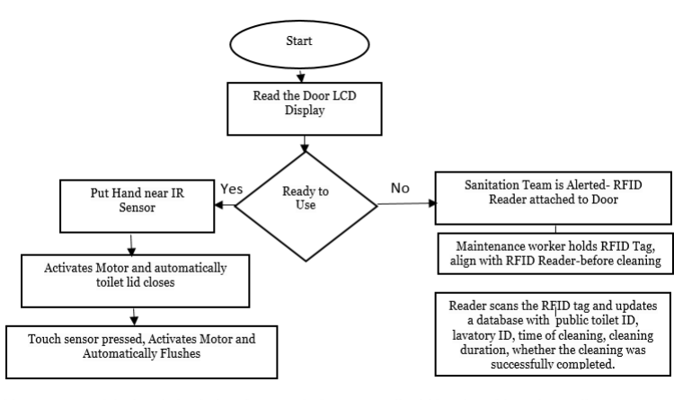
2.FLOW CHART

Slide 5
Anaerobic sewage tank is deeply buried and covered, the sewage liquid level could not be easily monitored. Traditional techniques like floating ball liquid sewage level determination requires to soak the floating ball in sewage liquid, the major setback is the floating ball gets strained over time and leads to malfunctioning. In our proposed system Ultrasonic sensor is fixed below the lower part of the tank cover plate. MAX485 is a low slew rate and low power transceiver, ported with Ultrasonic sensor for signal reception and transmission to microcontroller. The microcontroller output is connected to liquid crystal display, which displays real time liquid sewage level, if the level exceed the threshold alert signal is sent through buzzer.

Slide 6
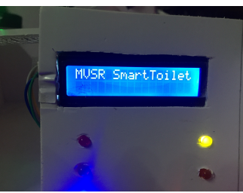
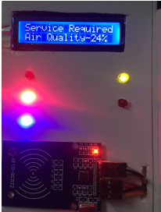
RESULTS AND DISCUSSION
1.LCD Monitor Displaying Status of Smart Toilet
2.LCD Monitor Displaying Status of Smart Toilet

Slide 7
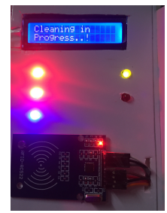
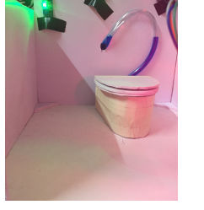
3. LCD Monitor Displaying Status of Smart Toilet
4.Automatic Lid Closure

Slide 8
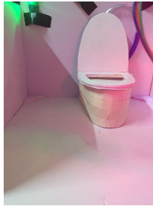
4.Automatic Lid Opening

